Slide 1

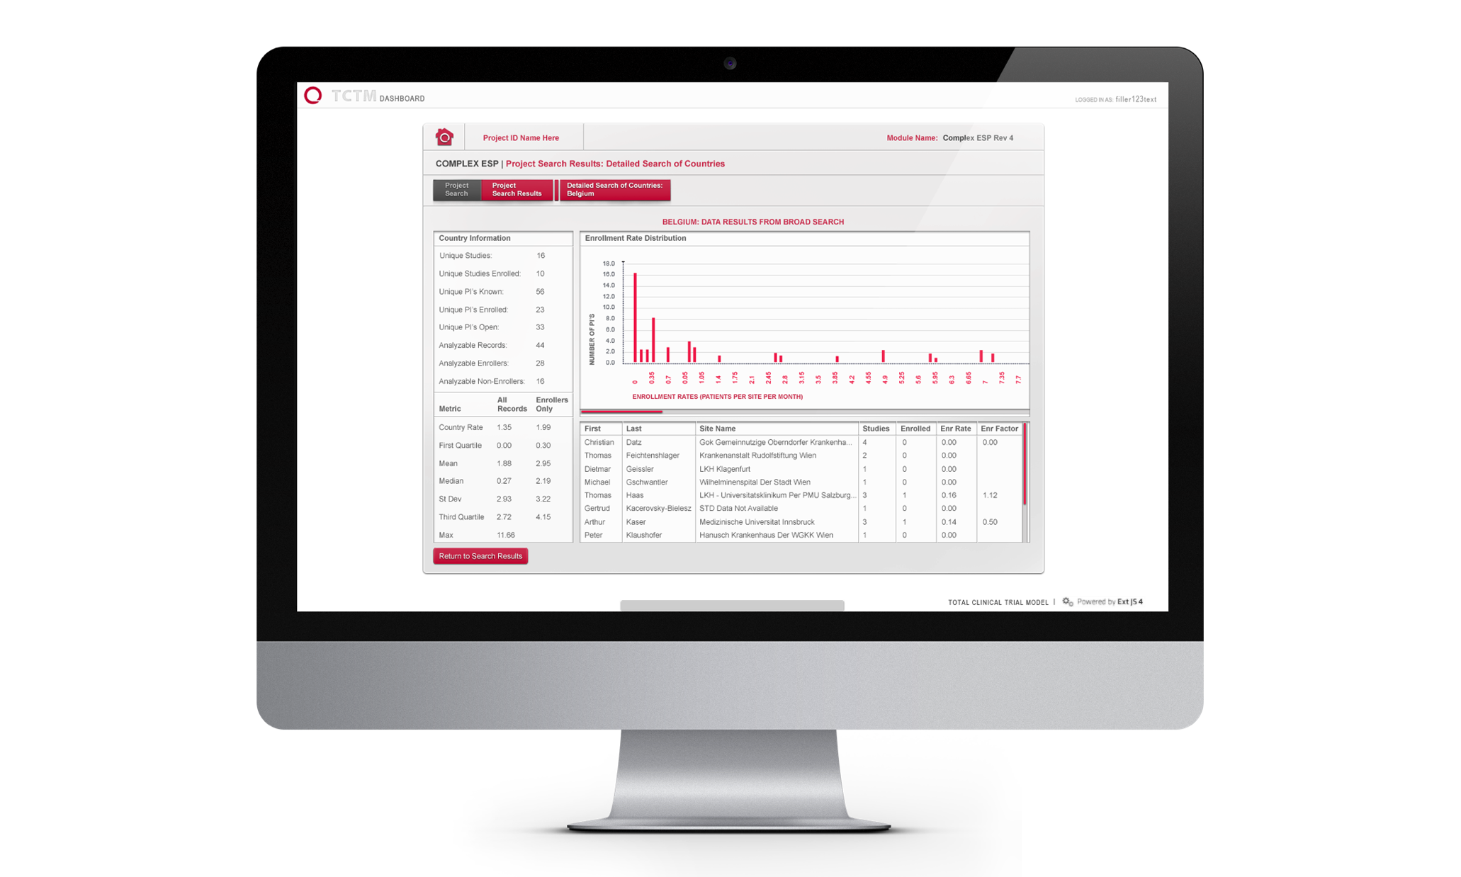
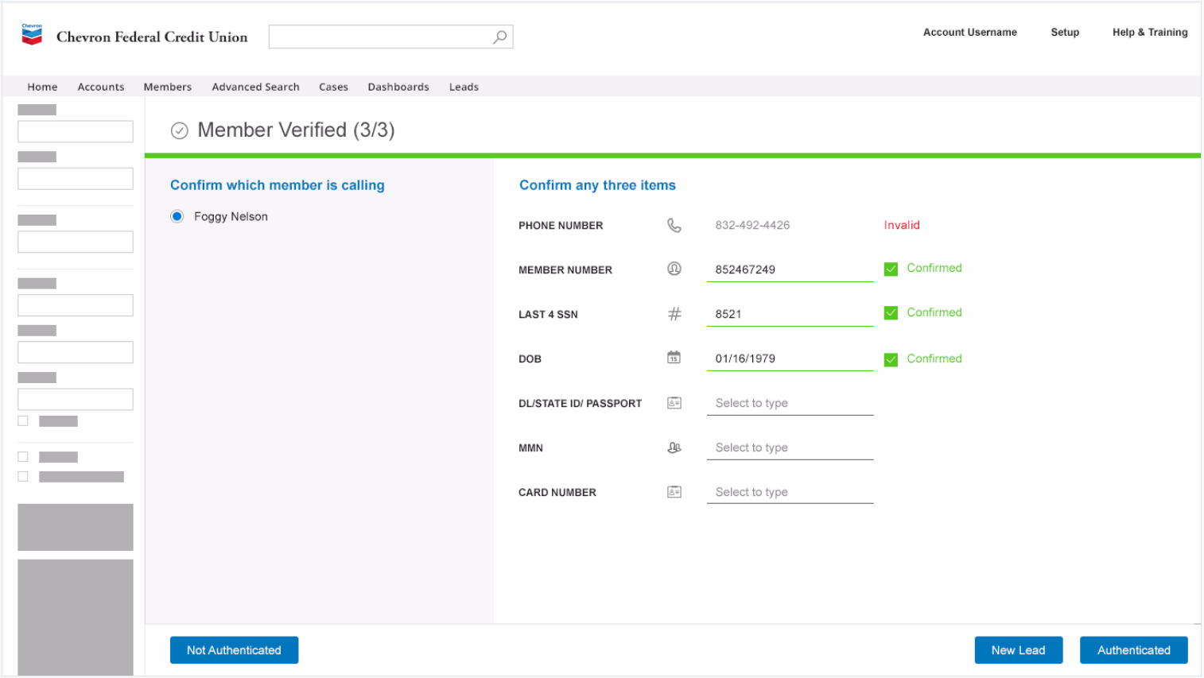
Chevron Credit Union – Development Team
Project-Based Work
Affirma initially partnered with Chevron FCU to implement Salesforce Communities and create a secure messaging portal with customized look and feel, & Single Sign-On integration to their Online Banking platform.
Affirma performed the entire conversion of CFCU’s Salesforce environment from their Classic solutions to the Lightning Experience.
Affirma developed a full integration between CFCU’s CTI/Telephony infrastructure and Salesforce to provide an automated score carding system that authenticates members over the phone before they reach call center representatives.
Team Size: 10
Location: WA, CA, India
Duration: 2016 - Present
Ongoing Managed Service Partnership
Flexible team of 8-14 resources including Developers, Architects, Project Managers, Business Analysts
Mix of resources on site with client, and remote from Affirma HQ and India
Integrated project management processes and platforms
Full augmentation of Application Architecture Design, Development Operations and support for Salesforce & integrated platforms across multiple client business groups.

